Slide 1

ONLINE TICKET BOOKING
Vinay raj
Arvind raj
Shweta Joshi
Arvind S

Slide 2
Languages used:
HTML:
The Hyper Text Mark up Language, or HTML is the standard mark up language for documents designed to be displayed in a web browser. It can be assisted by technologies such as Cascading Style Sheets (CSS) and scripting languages such as JavaScript.
CSS:
CSS stands for Cascading Style Sheets
CSS describes how HTML elements are to be displayed on screen, paper, or in other media
CSS saves a lot of work. It can control the layout of multiple web pages all at once
External stylesheets are stored in CSS files

Slide 3
Html Tags used:
<html> | Defines an HTML document
<head> | Contains metadata/information for the document
<title> | Defines a title for the document
<body> | Defines the document's body
<h1> to <h6> | Defines HTML headings
<p> | Defines a paragraph
<br> | Inserts a single line break
<hr> | Defines a thematic change in the content

Slide 4
CSS properties used :
1. CSS Variable :
CSS Variable properties are beneficial when we have to use something global available for my complete project, such as website colours.
2. Pseudo Elements
CSS Pseudo Elements is very useful when we insert any icon or anything before or after the HTML tag
3. Box Shadow
CSS Box Shadow is mainly used to achieve material or actual look box design.
4. CSS Flex
CSS Flex is very useful when we talk about alignments in design. We also said that advanced version of a float CSS property. By using flex, we can align our items vertically or horizontally and also in the group easily.

Slide 5
Design
1.Login page:
here we used form ,button tags to develop a login page after successful login it will go to the home page of ticket booking.
2.Home page :
for scrolling we have used marque tag
& divided the pages into 3 parts header body and footer .
3. Movie page:
where we are displaying movies based on the user requested location.
4.Movie description page:
it includes the Movie description and Theatre details and timings of shows.
5.Ticket booking page:
for selecting the seats and booking confirmation of seat.

Slide 6
Project git hub link
http://github.com/vinayrajvasan/movieticketbooking

Slide 7
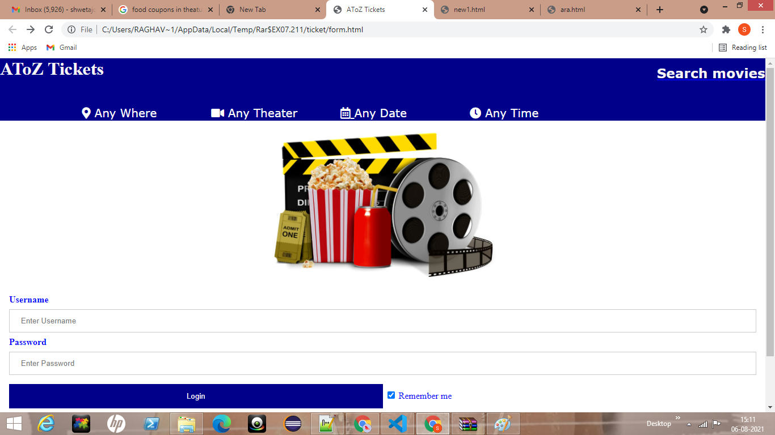
Result snapshots:
LOGIN PAGE

Slide 8
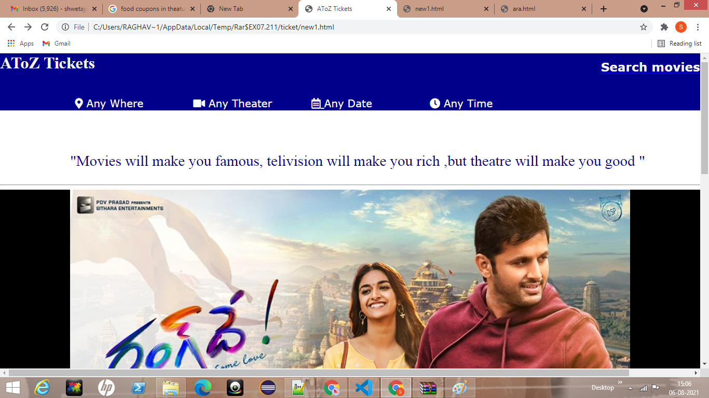
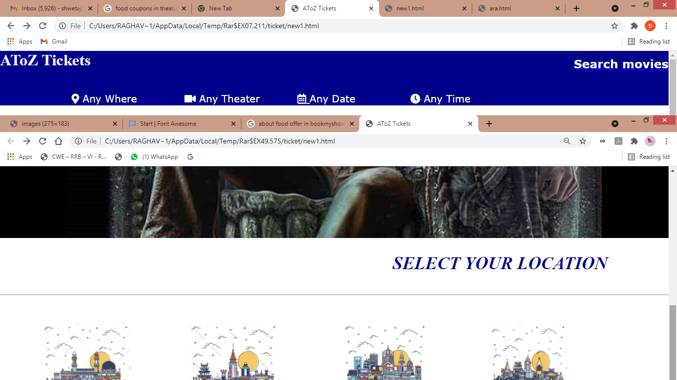
HOME PAGE:

Slide 9
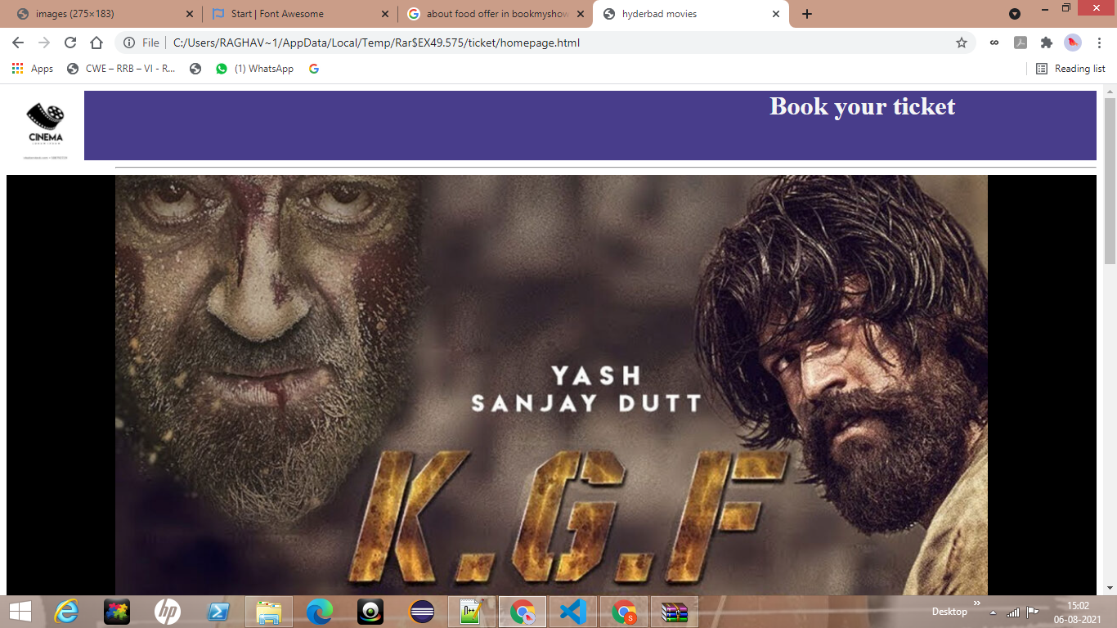
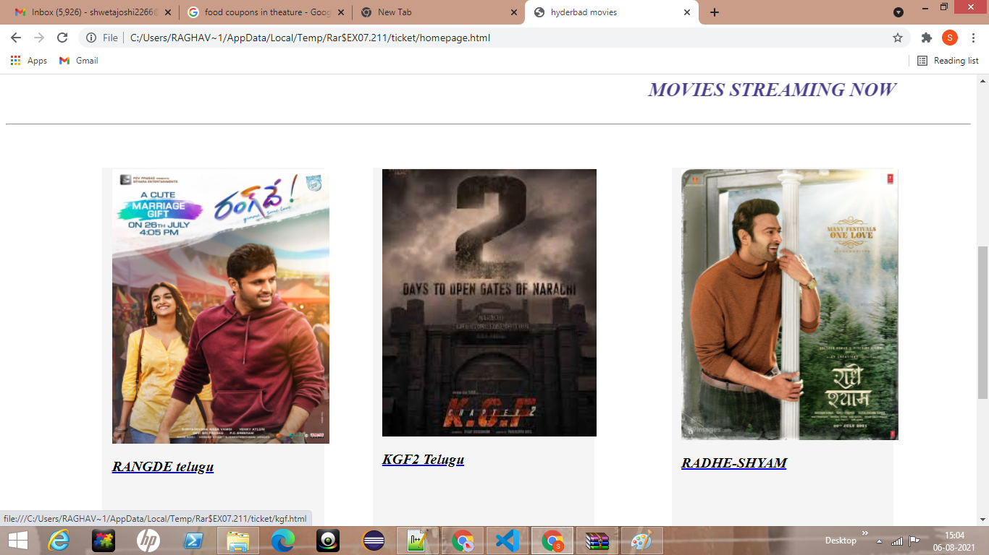
MOVIES PAGE:

Slide 10
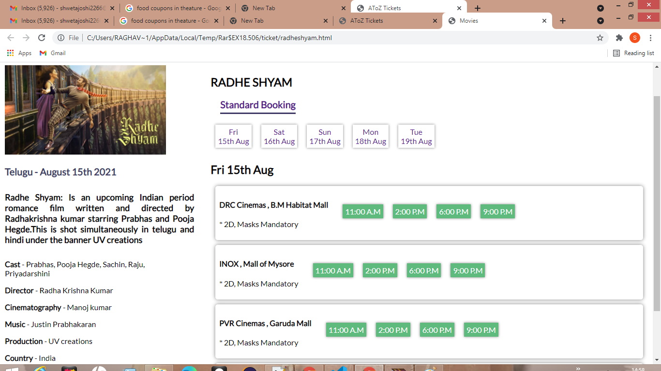
SHOW DETAILS PAGE:

Slide 11
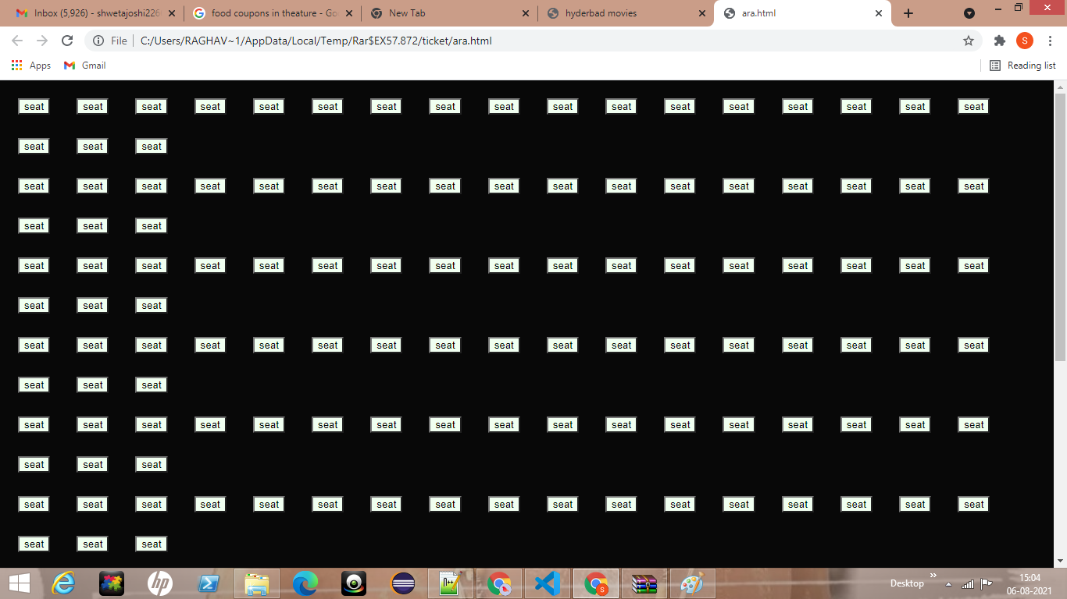
BOOKING COUNTER :

Slide 12
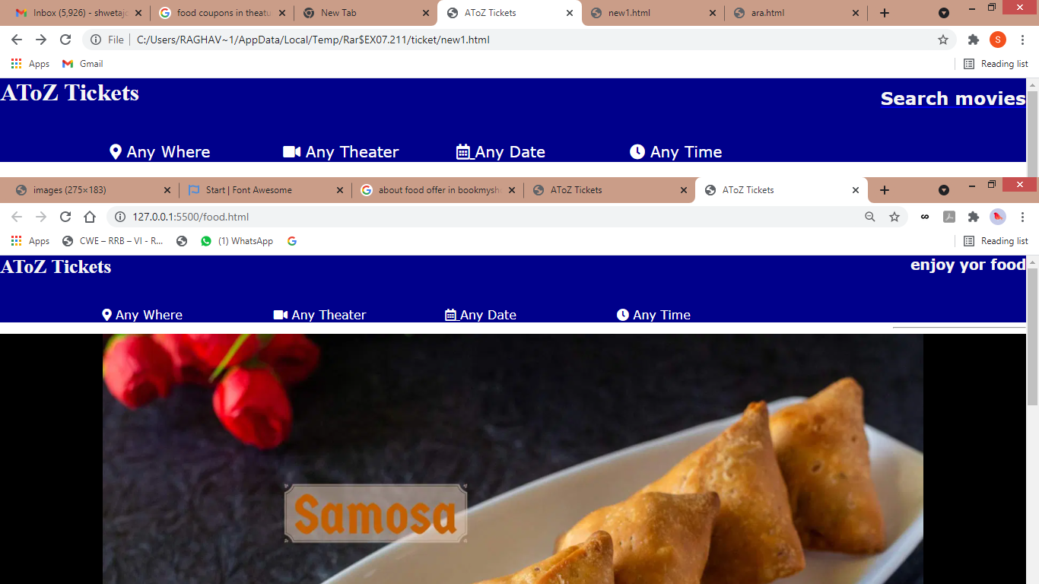
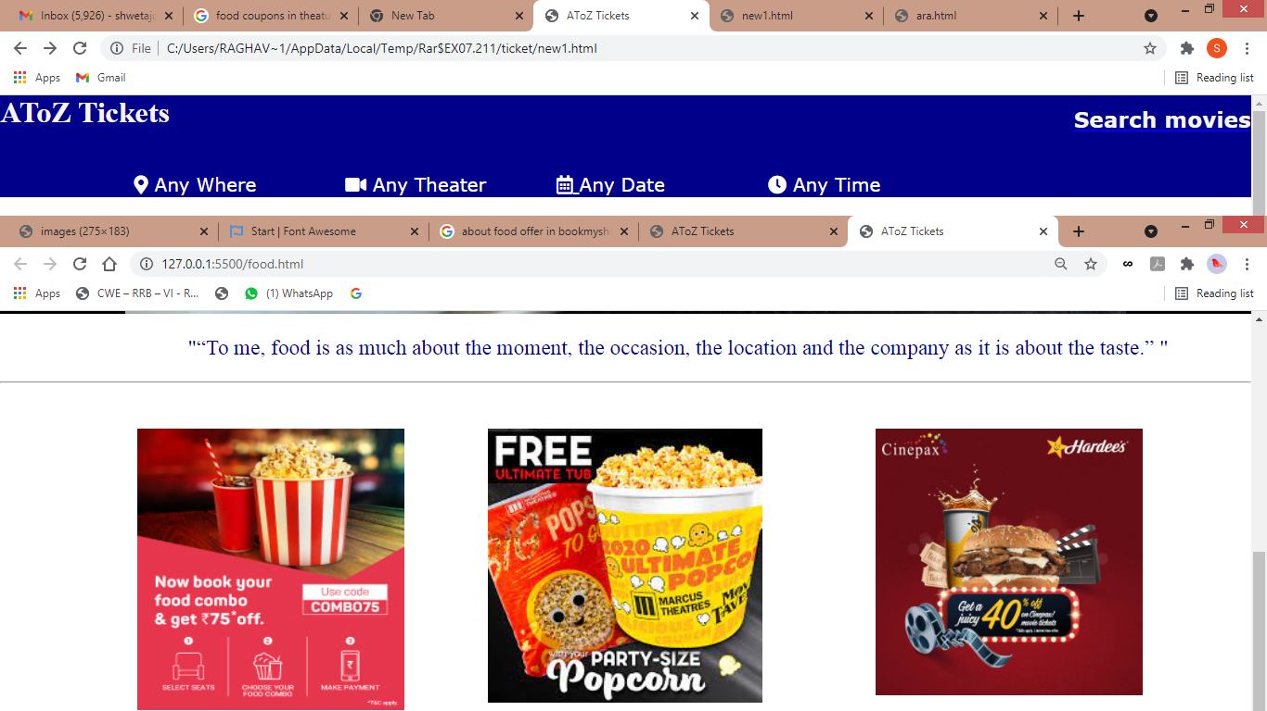
FOOD COUNTER

Slide 13
THANK YOU

